Slide 1
Contracts and Scheduling Agreement

Slide 2
Lesson Objectives
Overview of Outline Agreements
Scheduling Agreement
Contracts
Quantity Contracts
Value Contracts
Value Contract Types
Assortment Module
Group Master Contracts
Service Contracts
Contract Cancellation

Slide 3
Overview of Outline Agreements

Slide 4
Purpose
Purpose of Outline Agreements in SD
Agreements play an important role in nearly all business processes.
Customers and vendors agree on the goods to be provided under certain conditions and
within a specific timeframe.
Agreements streamline business processes for both partners in a business relationship.

Slide 5
Uses
Agreements aim at streamlining business processes of both customer and vendor.
Agreements can be effectively used to improve the efficiency in the following business areas.
Reduce costs
Increase quality
Increase speed of delivery

Slide 6
Challenges
How to meet specific pricing requirements in an agreements
How to incorporate various date relevant requirements (start date, end date, billing date etc.)
How confirm delivery date with assured quantities
How to deal with returns in agreements
How to ensure the data transfer between transactions

Slide 7
Overview of Outline Agreements

Slide 8
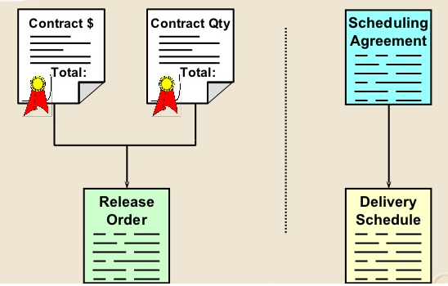
Outline Agreements
Contracts : Outline agreements with fixed quantity or value that a customer promises to order over a specified period of time, as well as the price involved. It requires a release order to make a delivery. Pricing (procedure and/or discounts) is copied to release order from the contract
Scheduling Agreements : Outline agreements with determined schedule lines. A delivery note is created directly from the scheduling agreement (release order is not required)

Slide 9
Scheduling Agreement Definition
Scheduling Agreement : An outline agreement with the customer against which materials are procured at a series of predefined points in time over a certain period containing delivery quantities and dates.
Usually a long term arrangement between two parties that outlines when a particular product/service is to be delivered – based on predetermined conditions and predetermined dates. The conditions are valid for a predefined period and predefined total purchase quantity
Since a scheduling agreement contains delivery dates and quantities, a delivery note is created directly from the agreement. Scheduling agreements are fulfilled by creating deliveries on the due date for the schedule lines. You must create your own schedule lines by entering the delivery dates requested by the customer. (via Schedule lines)
The scheduling agreement is used as a basis for delivering a material. The customer sends in scheduling agreement releases, referred to as delivery schedules, at regular intervals to release a quantity of the material

Slide 10
Features
There are many settings for scheduling agreements, giving the component supplier the flexibility needed to create and control documents to meet a company's specific needs.
A variety of sales functions for:
Engineering changes
Packing proposals
Open quantities
Returns
A variety of functions in delivery schedules for:
Intermediate documents (IDocs)
Checks on incoming delivery schedules
Requirements planning and delivery

Slide 11
Features
Tolerance levels
Analysis
Year changes
Cumulative quantities
Special shipping, billing, and external agent functions
Planning delivery schedule processing

Slide 12
Sales Contract
Definition: Contracts are agreements between the Customer and Vendor to supply materials/services for a specific price between a fixed period of time.
There are different types of contracts in SAP:
Quantity Contract
Value Contract
Service Contract
Master Contract

Slide 13
Quantity Contract
Definition: A quantity contract is an agreement to supply a fixed quantity over a period of time. Since the customer promises to buy the fixed quantity of goods/services, they will get a discounted price.
There are 2 primary reasons why quantity contracts are used:
When Quantity is Limited – When the production quantities are limited in numbers, then customers are allocated a specific quantity by time -period (say a month, or a quarter) . And customers cannot place ad-hoc orders, but have to first sign a contract for a fixed quantity and always order via release orders that specifically refer to the contract
When Vendors want to Lock-in Customer quantities – Some times to give deep discounts, sales folks require that customers commit to buying a fixed quantity over a time-period. This satisfies the sales figures
A customer submits a sales order to release products from the amount agreed in the quantity contract.

Slide 14
Value Contract
Definition:
A value contract is very similar to a quantity contract – except that instead of a fixed quantity, the value of the contract is fixed
A customer submits a sales order to release products from the value agreed in the contract

Slide 15
Service Contract
Definition:
A service contract is normally created for service-oriented items. (Repairs, Maintenance, contracts, etc.)
Follows a periodic billing plan
No deliveries or sales order typically
For example, when you buy an internet connection from a internet provider, they are providing services to you for a fixed period – say 1 year or 6 months. And for providing those services, they charge you monthly. In this case, there are no release orders because in case of service since there are no logistics operations, directly the customers are invoiced with reference to the contract. In this case, the customer is charged $100 a month for 12 months with a total of $1200. The items in these types of contracts follow billing-plan. Repairs also follow service contract methodology.
Profit Center Accounting

Slide 16
Master Contract
Definition: A master contract is used when a particular type of contract is created regularly for a customer and you want all the header data to be consistent across all of the contracts. Normally, the header data of a sales document contains data from the Customer master.
In this type of contracts only header data is transferred not line item details
Work in process
Scrap variances
Settlement

Slide 17
Scheduling Agreement

Slide 18
Scheduling Agreement
A scheduling agreement is an outline agreement between Company and Customer that is valid for a certain period of time. Scheduling agreements contain specific delivery dates in addition to target quantity and price information
Since a scheduling agreement contains delivery dates and quantities, a delivery note is created directly from the agreement. Scheduling agreements are fulfilled by creating deliveries on the due date for the schedule lines. You must create your own schedule lines by entering the delivery dates requested by the customer. (via Schedule lines)
In the scheduling agreement, the other functions can be carried out as in the order.

Slide 19
Scheduling Agreement
You must create your own schedule lines by entering the delivery dates requested by the customer. To create delivery dates for an item, select the item and go to “Item>Schedule lines. If the system cannot confirm the quantity specified on a given date, a second schedule line with the confirmed quantity and date will be automatically created.
A new type of scheduling agreement, called a delivery order has been developed for component suppliers. It represents a pick-up sheet, which functions much like a JIT delivery schedule, except that the pickup sheet is not renewed. The customer transmits material release data informing the component supplier of needed materials and the date the forwarding agent will pick them up.

Slide 20
Why Scheduling Agreement ?
Scheduling agreements are very much useful in industries where materials are produced in accordance with expected demand.
Example:
Suppose in automobile industry a car manufacturer produces 1200 cars in a year.
He on an average produces 100 per month.
Suppose he requires radial tires from XXXX company, he need not place an order for the entire
quantity he requires over an year.
Instead the company enters into an scheduling agreement with XXXX company which ensures timely supply according to the need of production run.

Slide 21
Scheduling Agreement Process
Run Delivery due list
Deliver Orders due for delivery
Create Scheduling Agreement
Create Billing

Slide 22
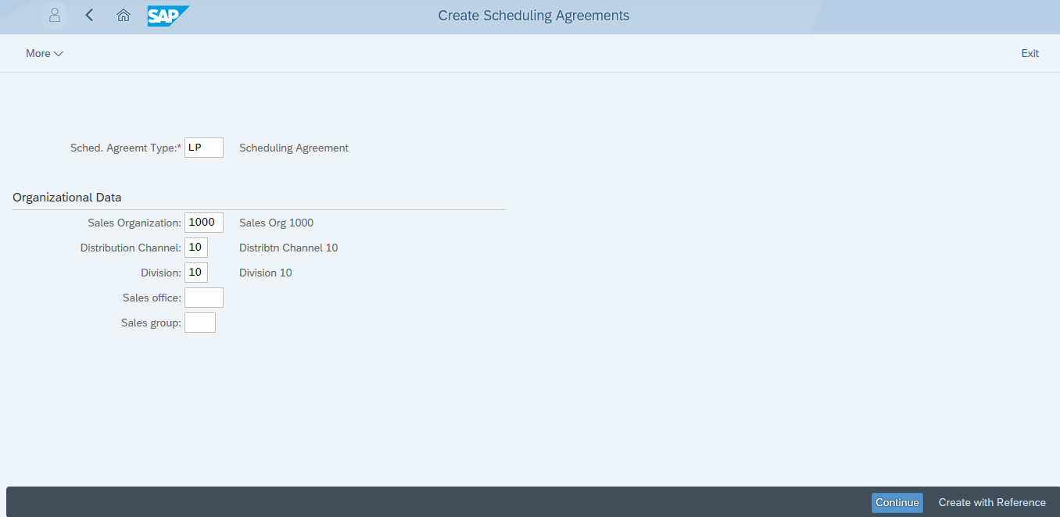
Create Scheduling Agreement
1.Enter Document Type
2.Enter Input Data
3.Continue

Slide 23
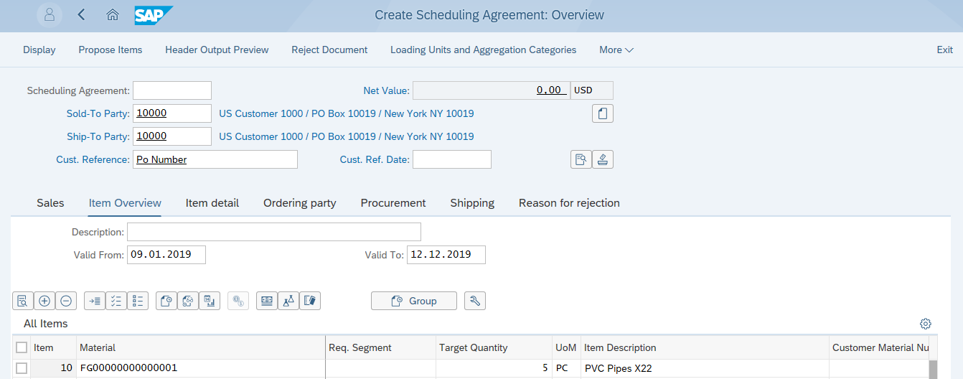
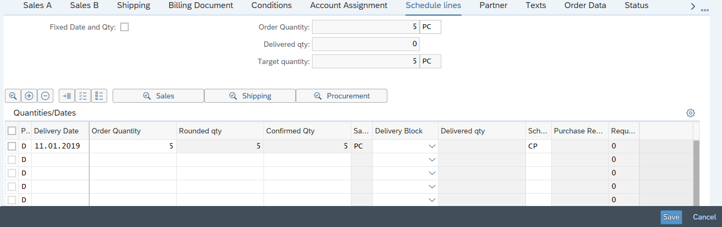
Create Scheduling Agreement
1.Enter Input Data
2.Enter Material
3.Enter Quantity
4.Enter Input Data
5.Save

Slide 24
Contracts
Quantity Contracts
Value Contracts
Value Contract Types

Slide 25
Contracts
A contract is an agreement stating that your customer will
order a certain quantity of product from you within a given time frame.
A Contract is an outline agreement between Company and Customer that is valid for a certain period of time and contains an overall target quantity or value that a customer agrees to buy at a specific price over a certain period of time; however, it does not contain specific delivery dates (no schedule lines or delivery information.)
Contracts are of 4 types.
Quantity contracts
Value contracts
Master contracts
Service contracts

Slide 26
Quantity Contracts
Quantity contracts are agreements between the customer and company to order specific quantities of a product within a set timeframe. The customer does not provide any information about delivery dates, only the start and end date of the contract. Quantity contracts are usually agreed to at discounts from totals if priced individually.
A quantity contract is fulfilled when the customer places orders against it in the contract period. These orders are known as release orders or ‘call-offs’. However, they are standard orders that automatically reference the customer’s quantity contract and reduce the remaining amount of product to be ordered under the contract.
If a customer can give delivery dates for the product, then it is preferable to use a scheduling agreement, instead of a quantity contract.

Slide 27
Quantity Contract Processing
Create release Sales order with reference to the Quantity contract
Deliver Orders
Create Quantity Contract
Create Billing

Slide 28
Releasing The Quantity Contract
Release orders are created referencing the Quantity contract.
Release orders created update the quantity contract.
Since the contract does not contain any schedule lines or delivery information, a customer must fulfill the contract by placing a purchasing order against quantity contract.
If you try to change a contract after the release order creation, the system warns you that subsequent documents exist.

Slide 29
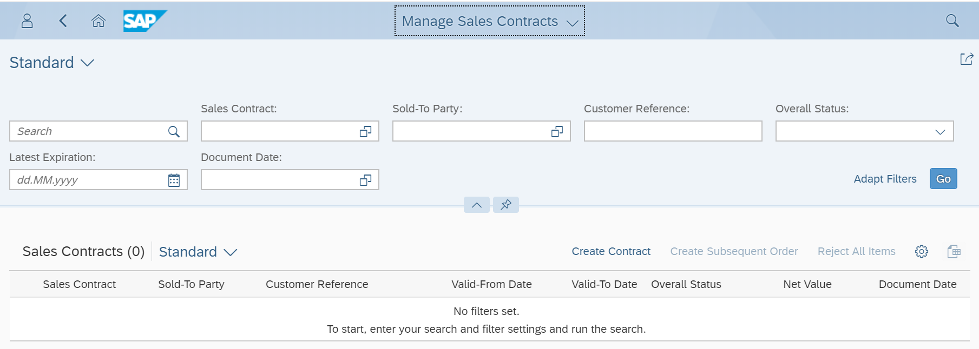
Manage Sales Contracts
1. Already created contract can be searched using any input parameter
2. Click on “Create Contract” button

Slide 30
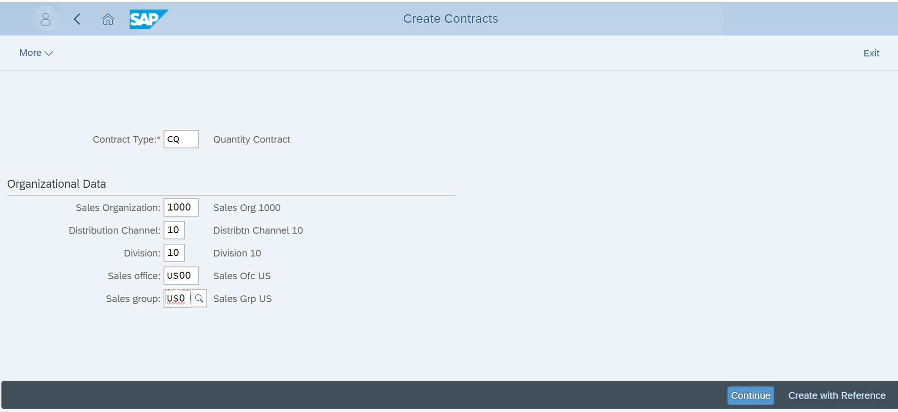
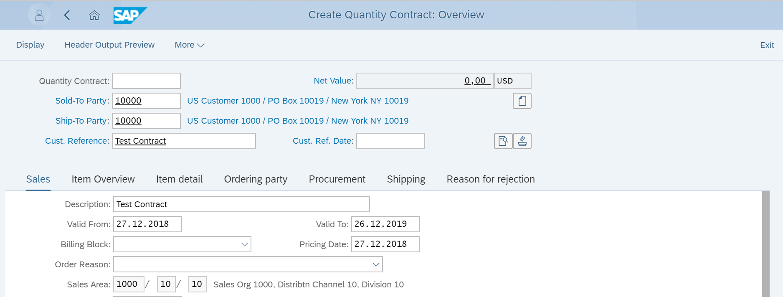
Manage Sales Contracts
1. Enter all the inputs parameters
2. Click on Continue button
3. Enter all the inputs parameters
4. Enter Validity

Slide 31
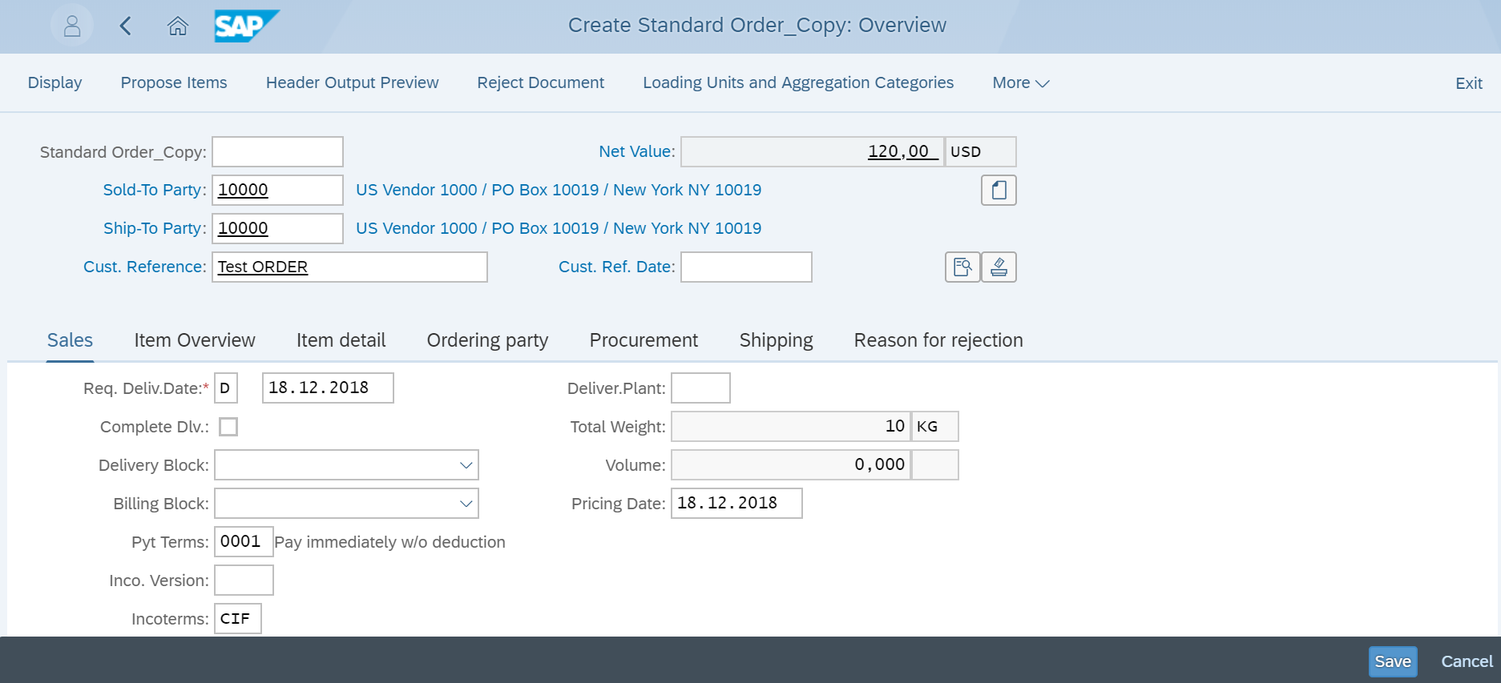
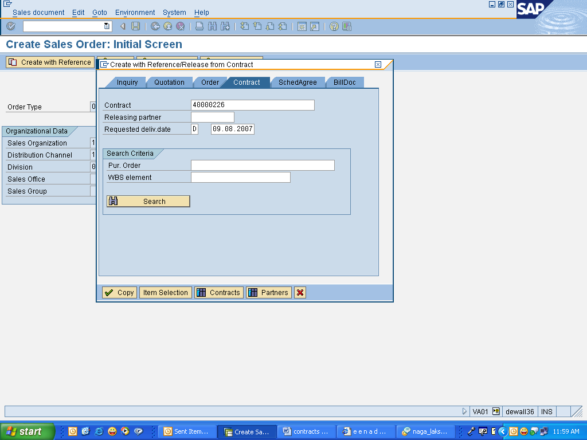
Release the Quantity Contract
Logistics>Sales and Distribution>Sales>Order>Create (VA01)
Fiori Tile : Manage Sales Order

Slide 32
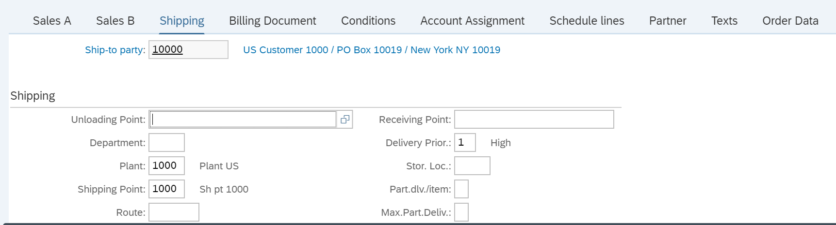
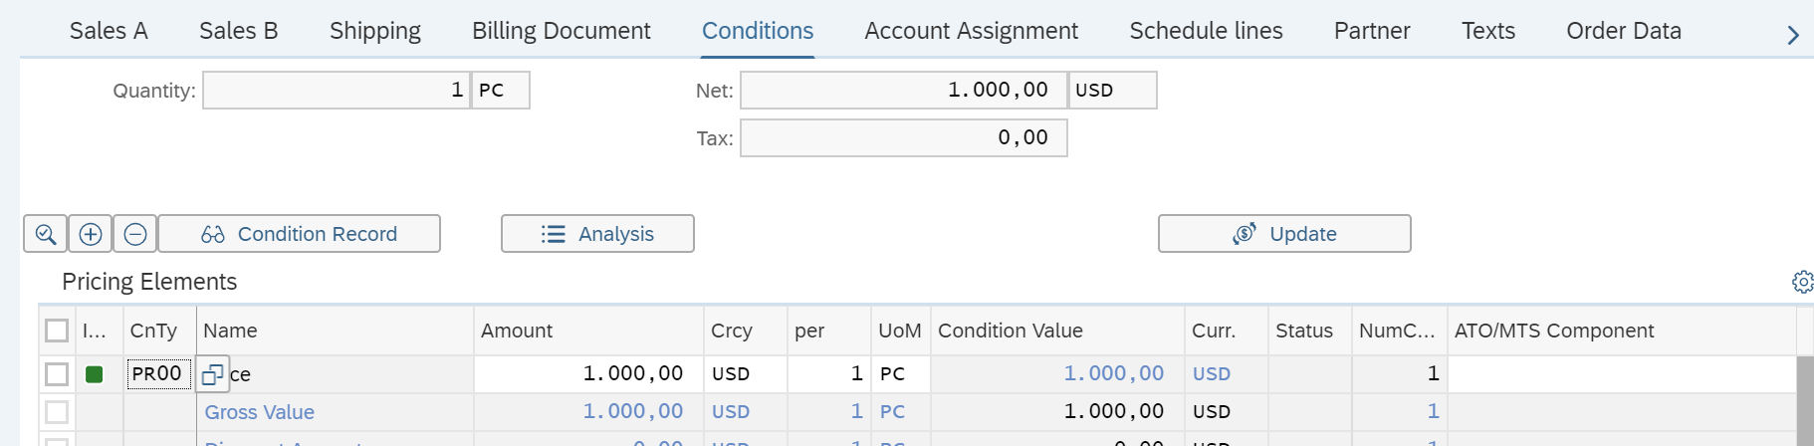
Release the Quantity Contract
3. Delivery priority
1. Plant at item level
2. Shipping point
4. Net value
6. Tax
5. Base price for item

Slide 33
Value Contracts
A value contract is a value based outline agreement with a customer in which it is agree
that a certain value of products will be purchased over a period of time.
Value contracts contain:
Validity period
The agreed upon total value
Rules controlling the who can release against the contract through partner authorizations
Restrictions regarding what materials can be ordered against the contract

Slide 34
Value Contract Process
Create release Sales order with reference to Value contract
Create Value Contract
Deliver Orders
Create Billing
NOTE: Assortment module is created to club the materials for which the value contract should be updated. We can also create a value contract for a single material.

Slide 35
Value Contract Types
There are Two types of value contracts:
Standard value contract: It is used in majority of instances. It is based on total value of an assortment of materials for a particular Customer. We use document type WK1 for these type of contracts.
Material Related Value Contract: it is based on a single material (usually configurable material). We use document type WK2 for these type of contracts.

Slide 36
Releasing The Value Contracts
Release orders are created referencing the value contract.
The system checks the released materials against the rules of the value contract as well as whether the release is within the validity period of the value contract.
The value of the released material is checked against the remaining open value of the contract. It is possible to define whether a value contract quantity can be exceeded or not.
Value contracts can be billed directly or billed per release order.
When billing documents are billed directly, a billing plan can be used.

Slide 37
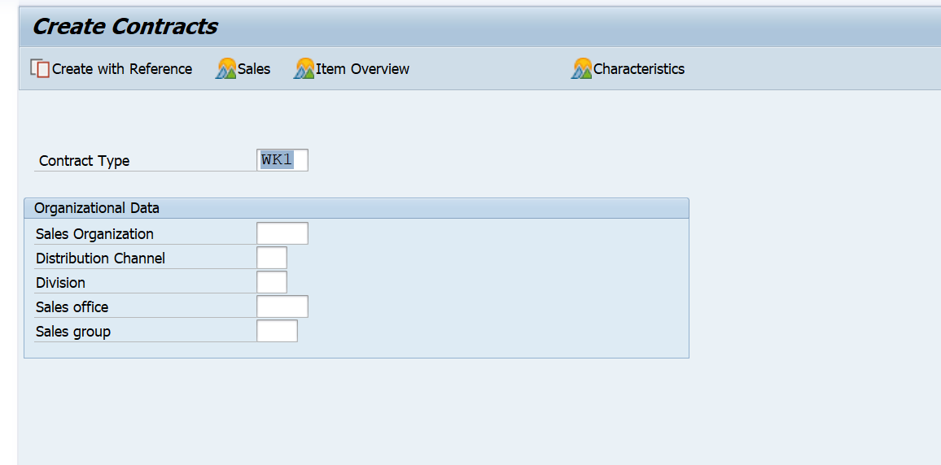
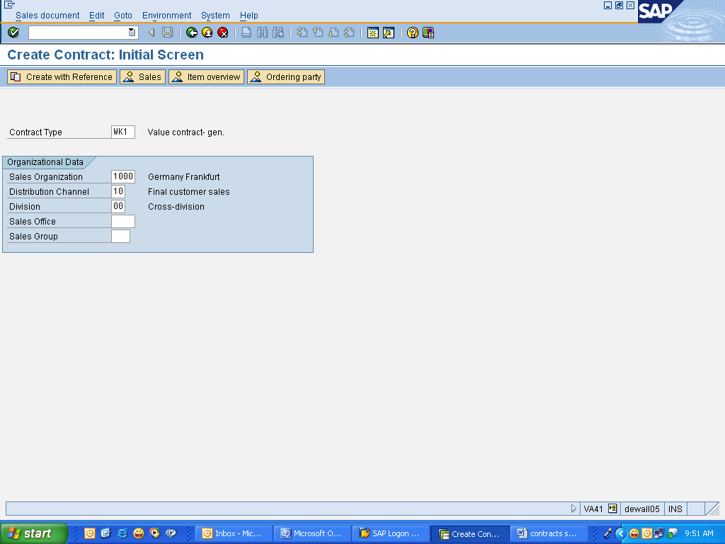
Create Value Contract
Logistics>Sales and Distribution>Sales> Contracts->create (VA41)

Slide 38
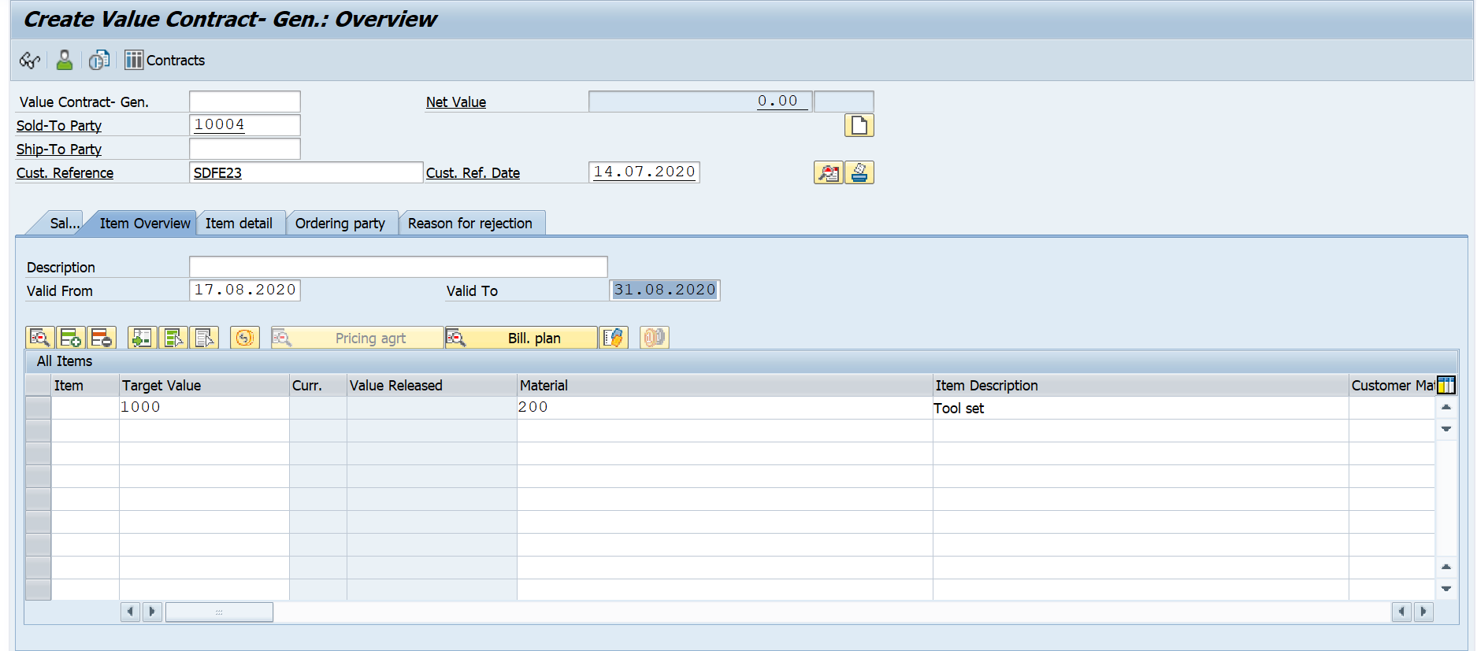
Create Value Contract

Slide 39
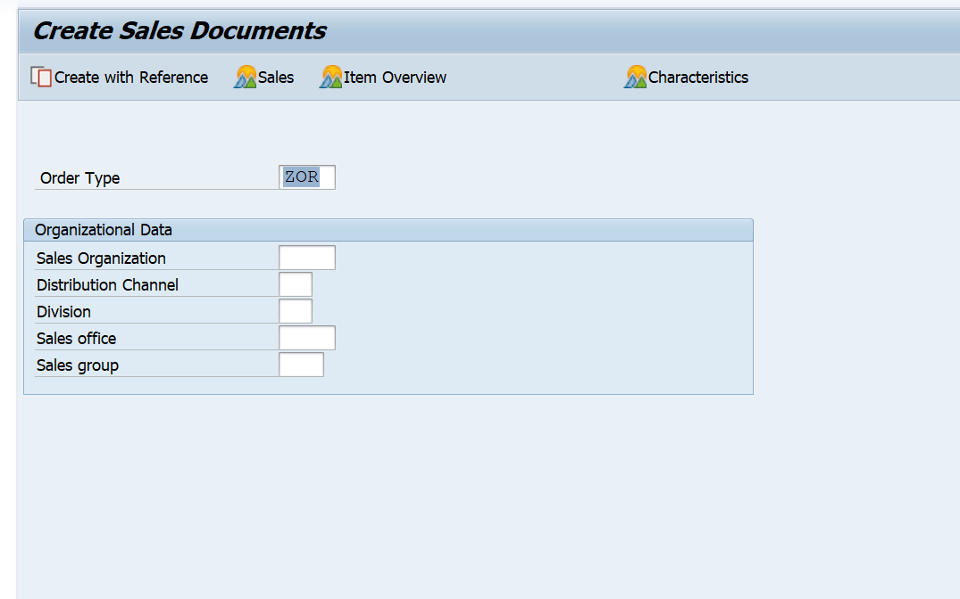
Release Value Contract
Logistics>Sales and Distribution>Sales>Order>Create (VA01)

Slide 40
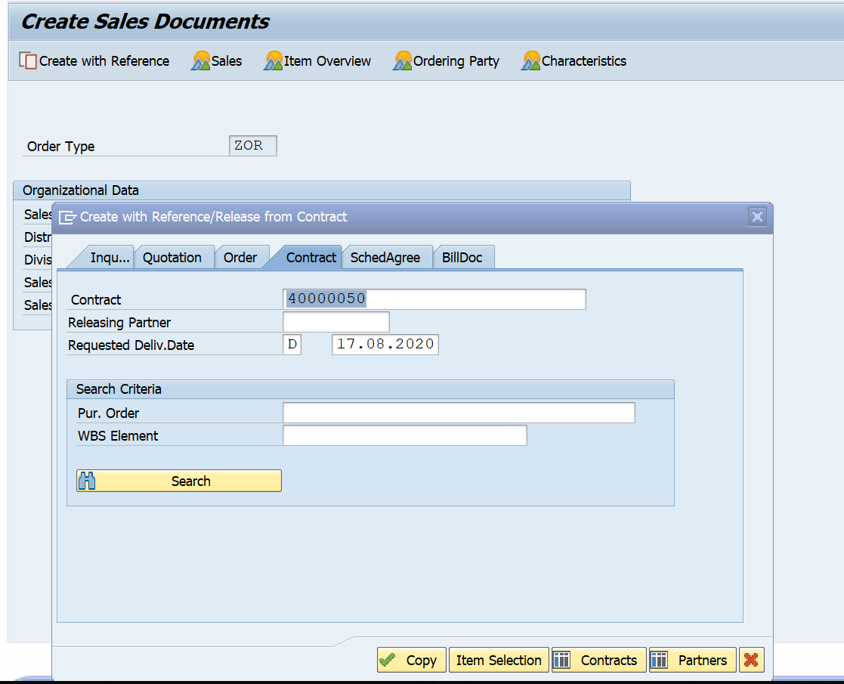
Release Value Contract

Slide 41
Assortment Module

Slide 42
Assortment Module
An Assortment Module is an order entry tool that displays a list of materials and services that can be released from a value contract. It has a validity date and a restriction that only the materials and services that belong in the same sales organization and distribution channel for which your release order is being made will be displayed.
Assortment modules for value contracts are maintained in the master data for products. You can define a validity period for each material in the assortment module. When you create a release order, the system checks the respective entry date against the validity period.
If you have not made any entries in the document, all the materials defined in sales can be released unless there are any other restrictions in copying control at item level

Slide 43
Assortment Module
Assortment modules support the assortment strategy you have planned.
Each module contains an assortment which applies to all stores and which only becomes store-specific after a suitable assignment has been made.
Special form of the traditional module types is the value contract module.
The value contract module is generally only used to group together materials for value contracts, but it can be used exactly like a standard module in assortment functions.
The Procedure:
Enter a module type. Promotion modules cannot be created in this transaction; they can only be created from within the promotion itself.
Profile modules are created directly during integrated material maintenance and can only be edited here to a limited extent. If you wish to maintain a local module for a single plant, enter the plant number in the 'local assortment' field.

Slide 44
Assortment Module
An assortment module is a grouping of materials, which make up its items. It is assigned to assortments. It is valid for a certain period of time and has a maximum assortment priority. Assortment modules belong to different module types.
The value contract module is a special form; it can be used not only in assortment functions but also to group materials into value contracts.

Slide 45
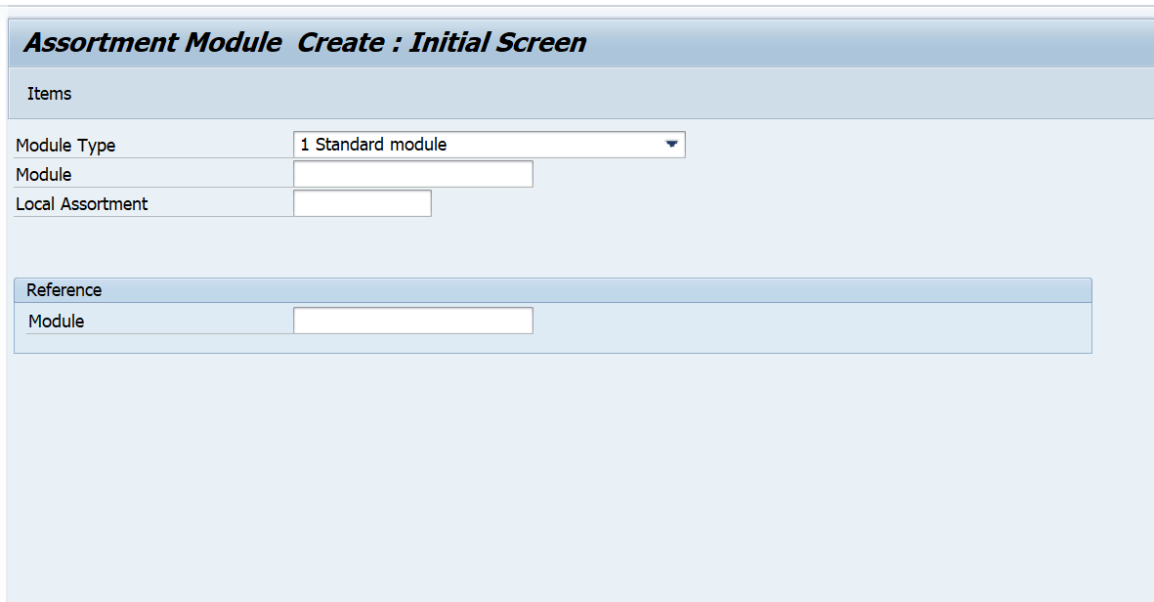
Assortment Module Create

Slide 46
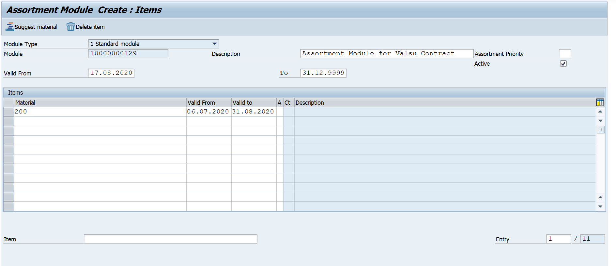
Assortment Module Create

Slide 47
Group Master Contracts

Slide 48

Group Master Contract Process
Contracts can be grouped and assigned to a Master Contract
All Contracts assigned to the Group Master Contract should be created in the same sales area.
Quantity Contract
Value Contract
Service Contract
Group Master Contract

Slide 49
Group Master Contracts - Example
Master Contract - GK 40000017
Sold To Party 6 Hughes Aircraft Head Office
Contract Start: 09/01/1998 End:09/01/1999
Ref. Procedure GKCQ
Lower Level Contracts
40000018 Hughes Aircraft - NY 10/01/1998 - 11/15/1998
40000019 Hughes Aircraft - PA 11/01/1998 - 12/31/1998
CONTRACT(CQ) 40000018
Customer 6
Description: Hughes Aircraft-NY
Master Contract: 40000017
Material Quantity
XYZ 100
CONTRACT(CQ) 40000019
Customer 6
Description: Hughes Aircraft-PA
Master Contract: 40000017
Material Quantity
A9 250
Link to master contract created
at level of lower contract

Slide 50
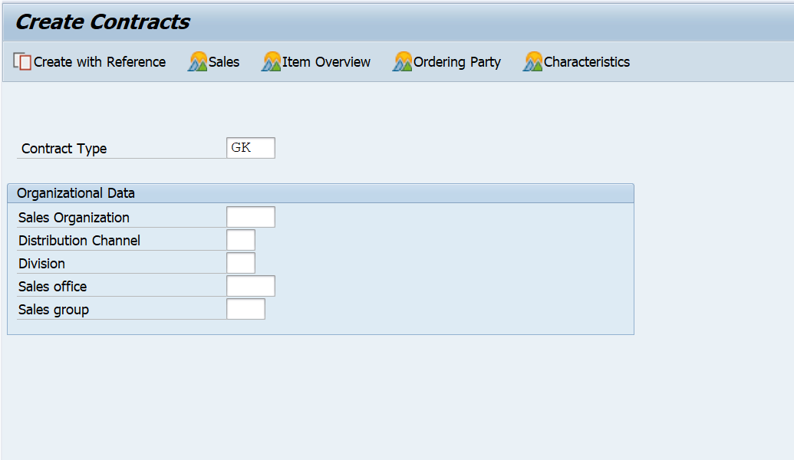
Group Master Contracts – Create

Slide 51
Service Contracts

Slide 52

Service Contracts
A service contract is an agreement that contains the conditions for offering a certain service to the customer. You can manage rental and maintenance contracts in the standard version of the SAP R/3 System. A service contract contains validity dates, cancellation conditions, price agreements, and information on possible follow-up actions.
Element of the service contract in which you define the services or products you are providing the customer with under the terms of the service contract.

Slide 53

Continued…
A service contract describes which services are to be performed, for which objects, and under which conditions.
A service contract consists of a header and one or more items. The header and each item can contain the following data:
Pricing conditions
Contract data
Text
Status
Partner data

Slide 54

Releasing The Service Contracts
Release orders are created referencing the service contract.
The system checks the released materials against the rules of the service contract as well as whether the release is within the validity period of the service contract.

Slide 55
Service Contract Process
Create release Sales order with reference to Service contract
Create Service Contract
Create Billing

Slide 56
Contract Cancellation

Slide 57
Contract Data in Sales Document
The contract start and end dates can be entered manually or determined automatically. The system can propose these dates upon document creation according to a date determination rule which can be proposed for the contract type.
Sales document types are used to control whether or not additional contract data is allowed. Contract data can be maintained at header and item levels. Contract data at header level is valid for all items as long as different data is not entered at item level.
In addition to the contract start and end dates, contract data includes the Installation Date, the Contract Signed Date, and the Dismantling Date. These dates are manually maintained in a contract and can be used to determine the contract start and end dates.

Slide 58

Contract Cancellation
For canceling a contract we use the document type ’CQ’
The following information is required while canceling contracts
Reason why the contract is cancelled.
When will be the cancellation effective.
Once the contract is cancelled we cannot create release Orders with respect to contracts.
We cannot cancel a contract after its validity is over.

Slide 59
Configuration

Slide 60
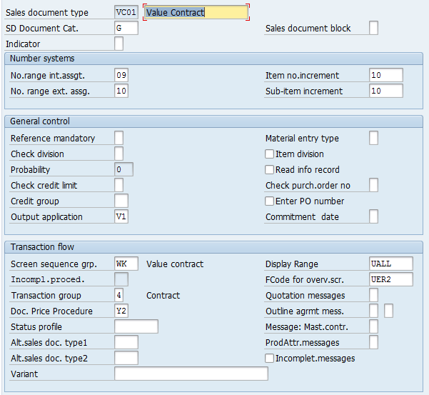
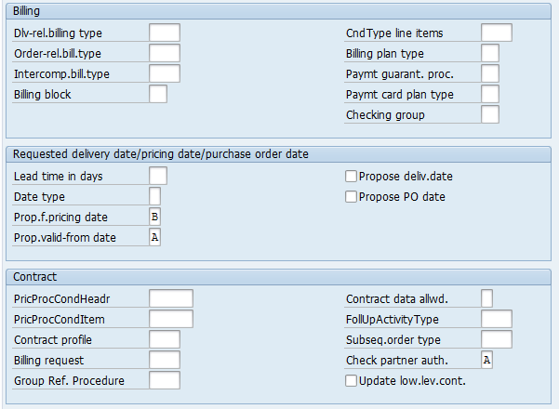
Value Contract-Configuration
SPRO→ Sales and Distribution→ Sales→ Sales Documents→ Sales Document Header→ Define Sales Document Types (VOV8)

Slide 61
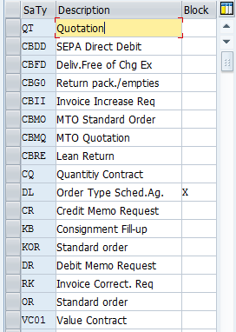
Create the Outline Agreement Document Types(VOV8)
SPRO→ Sales and Distribution→ Sales→ Sales Documents→ Sales Document Header→ Define Sales Document Types (VOV8)

Slide 62
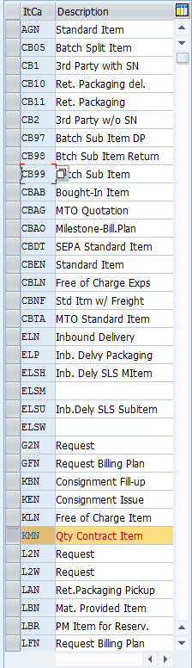
Create the Outline Agreement Item Categories(VOV7)
SPRO→ Sales and Distribution→ Sales→
Sales Documents→ Sales Document Item→ Define Item Categories(VOV7)

Slide 63
T-Codes
Use the Transaction Codes below to view the configuration settings for Sales Document Type, Item categories, Schedule Lines, Create the Scheduling agreements and Contracts.
VA31 | Create Scheduling agreements
VA41 | Create Contracts
VA01 | Release the Contracts( with Reference contracts)
VOV8 | Define Sales Document Types
VOV7 | Define Item categories
VOV6 | Define Schedule lines
VOV5 | Schedule line Determination
VOV4 | Item Category Determination

Slide 64
Outline Agreements
To have more information,
http://help.sap.com/saphelp_47x200/helpdata/en/75/ee0e9755c811d189900000e8322d00/frameset.htm
http://help.sap.com/saphelp_erp2004/helpdata/EN/dd/55fd53545a11d1a7020000e829fd11/frameset.htm
http://help.sap.com/saphelp_erp2004/helpdata/EN/dd/56045d545a11d1a7020000e829fd11/frameset.htm

